Slide 1

Notes:
Entrance music plays; when music fades, Eric begins speaking

Slide 2
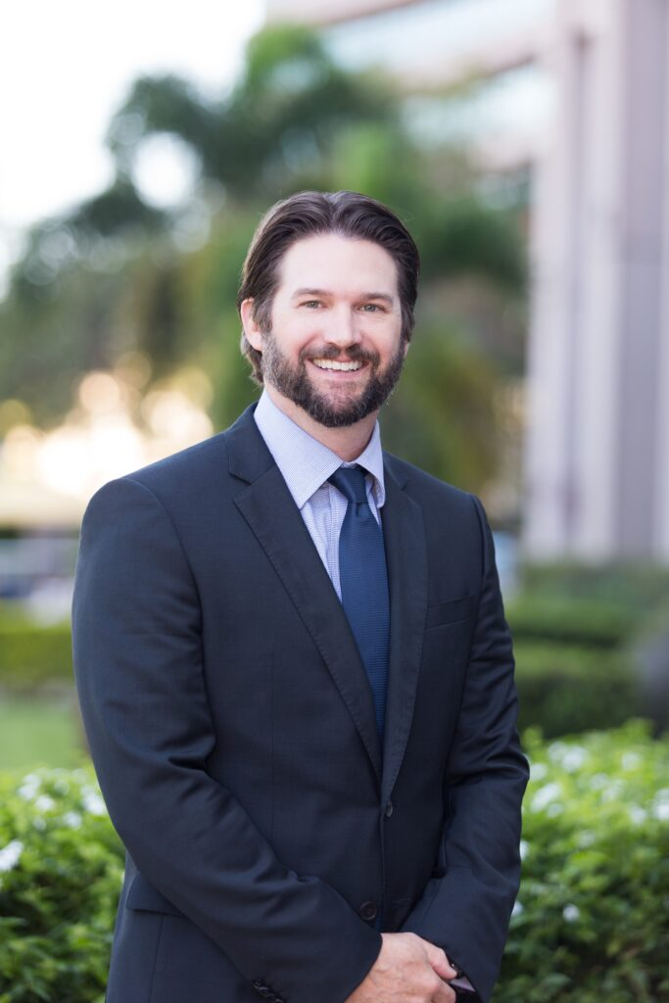
Welcome
Eric Sauers
PhD, ATC, FNATA, President
Notes:
Good morning everyone and welcome to the 2021 CAATE Accreditation Humanizing AT Conference in Orlando Florida. It’s my great pleasure to be here with you and to kick off what I know is going to be a fantastic day of educational programming to advance the mission of the CAATE.
As you can all imagine, a tremendous amount of work has gone into putting this meeting together. So, I’d like to acknowledge here and say thank you to all of our speakers, moderators, members of the Education Committee and our fantastic staff at the CAATE.
I’d like to specifically acknowledge the leadership and tremendous effort of Dr. Lindsey Eberman who chairs our Education Committee. That group has done a fantastic job and she has worked incredibly hard to ensure we are providing the best possible educational content for the needs of current programs now and in the future.

Slide 3
Thank You Volunteers
Thank you to our committee members for your help throughout the year.
Diversity Equity and Inclusion Committee
Education Committee
Finance Committee
International Committee
Peer Review Committee
Review Committee
Standards Committee
Notes:
We want to take moment to thank the committees for their service and their commitment to the CAATE mission.
INSERT ERIC’S NOTES
And with that, I will now turn it over to Dr. Eberman to give an overview of the Conference today.

Slide 4
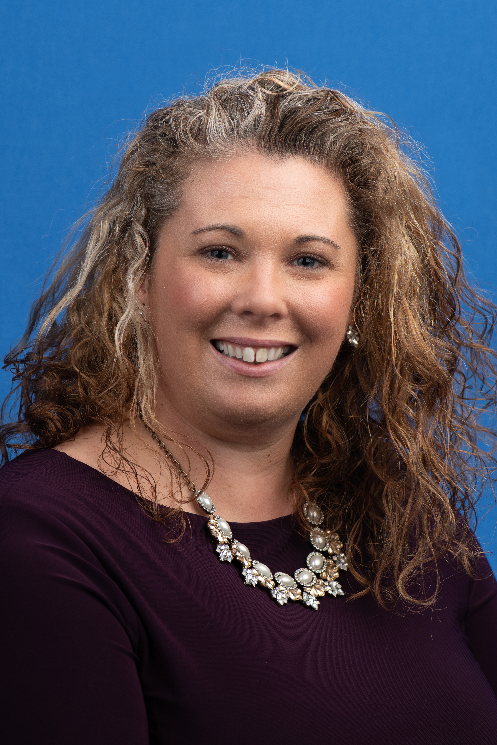
Education Committee
Members
Jessica Edler, PhD, LAT, ATC
Nikki Harris DAT, LAT, ATC, CSCS
Jamie Mansell, PhD, LAT, ATC
J’nai Pittman MsEd, LAT, ATC, ATC
James Reidy MS, ATC, CSCS
Gail Samdperil, EdD, ATC
Stacy Walker PhD, ATC, FNATA
Zachary Winkelmann PhD, SCAT, ATC
Lindsey E. Eberman
PhD, LAT, ATC,
Chair
Notes:
Thank you! Conference Planning is just one of the things we do. This team has produced the same volume of educational content throughout the year as is being presented this weekend! Much of that is through collaborations with all the other Committees and volunteers. We are so grateful to your contributions.

Slide 5

How We Use Your Feedback
Modes of engagement
Diverse perspectives
Virtually accessible, on-demand Conference content
Photo by Samantha Borges on Unsplash
Notes:
We have continued to use your feedback to curate content during the conference and throughout the year using multiple modes of engagement: asynchronous and synchronous, discussions and lectures, workshops and webinars.
Inviting Conference Submissions and engaging presenters that represent diverse cultural and ethnic backgrounds, levels of ability, gender identity and sexual orientation, educational training, institution size, and perspective. We want to embody inclusive excellence in our work and are hopeful you have seen that in the educational materials produced throughout this weekend and on an annual basis.
We have heard your needs to make content accessible on-demand, especially Conference content. In all sessions where consent has been given, we will be providing a virtual version of the materials, including access to the slides and recordings. We encourage you to reach out directly to speakers for additional information as needed.
Updates from our Strategic Alliance Partners can be viewed on demand on the CAATE website in a series of videos. Thank you for your continued work in the mission of the CAATE!

Slide 6

Humanizing Athletic Training Education
Broad and whole-person approach to education
More than cognitive and behavioral needs of students
Considering student motivations
  Goals, aspirations, and end states
  Altruism
Photo by Peter Fogden on Unsplash
Notes:
This year’s conference theme is “Humanizing Athletic Training Education.” The humanistic learning theory asks that we consider a broad and whole-person approach to education. The theory suggests we must consider more than the cognitive and behavioral needs of athletic training learners, but we also must consider their social and emotional needs. I sense that most educators in higher education are experiencing a need to educate to the social and emotional needs of learners more than ever because of the pandemic. No one more so than healthcare educators. Our students are experiencing the pressures of higher education in a pandemic compounded with the pressures of working in healthcare in a pandemic. Their social and emotional educational needs are critical to their successful matriculation and retention in our profession.
Part of integrating the humanistic approach into your program is considering the motivations of our students as we create an ideal learning environment. For most future healthcare professionals, altruism, the concern and well-being of others, is at the core of what we do. Throughout the conference you will find content that aligns with the principles of altruism, whole-person healthcare, and patient-centered care. This includes the social determinants of health, diversity, equity, and inclusion, cultural agility, and interprofessional and collaborative care. In addition, as you attend other sessions that speak to the infrastructure of your program, we challenge you to consider how to deliver your program through a humanistic lens.

Slide 7
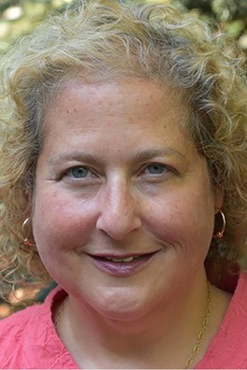
Welcome Keynote Speaker
Dr. Abby Ferber
Professor
Sociology, and Women’s and Ethnic Studies
Associate Director
Matrix Center for the Advancement of Social Equity and Inclusion
University of Colorado
Colorado Springs
Notes:
Dr. Abby Ferber will challenge each of us to proceed with clarity in this mission of Humanizing Athletic Training.

