Slide 1

Incorporating Social Determinants of Health into Athletic Training Education
Kelsey J. Picha, PhD, AT
Rhianna Freiburger, MS, ATC; Cailee E. Welch Bacon, PhD, ATC
Alison R. Snyder Valier, PhD, ATC, FNATA

Slide 2
Objectives
Appreciate the importance of engaging athletic training students with social determinants of health to improve their ability to identify social factors at the point-of-care
Implement an innovative teaching technique to engage athletic training students with social determinants of health at the point-of-care

Slide 3
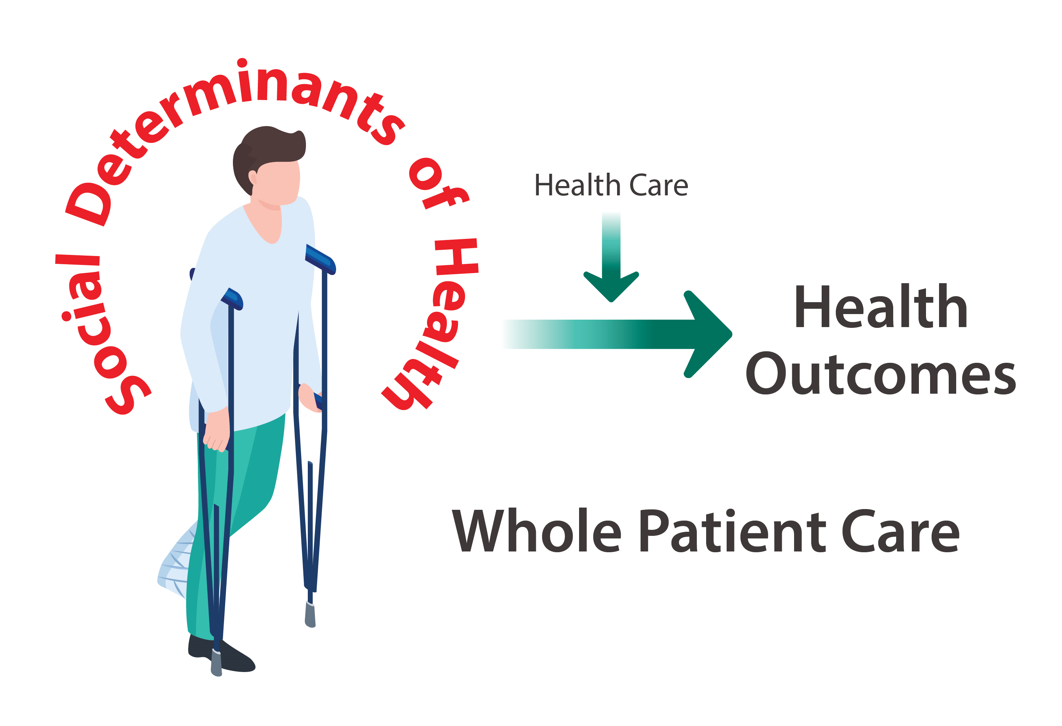
= 20%

Slide 4
What are Social Determinants of Health (SDH)?
The conditions in which people are born, grow, live, work, and age
They are complex conditions that shape the overall health of an individual on a continuous basis
(WHO, 2016)

Slide 5
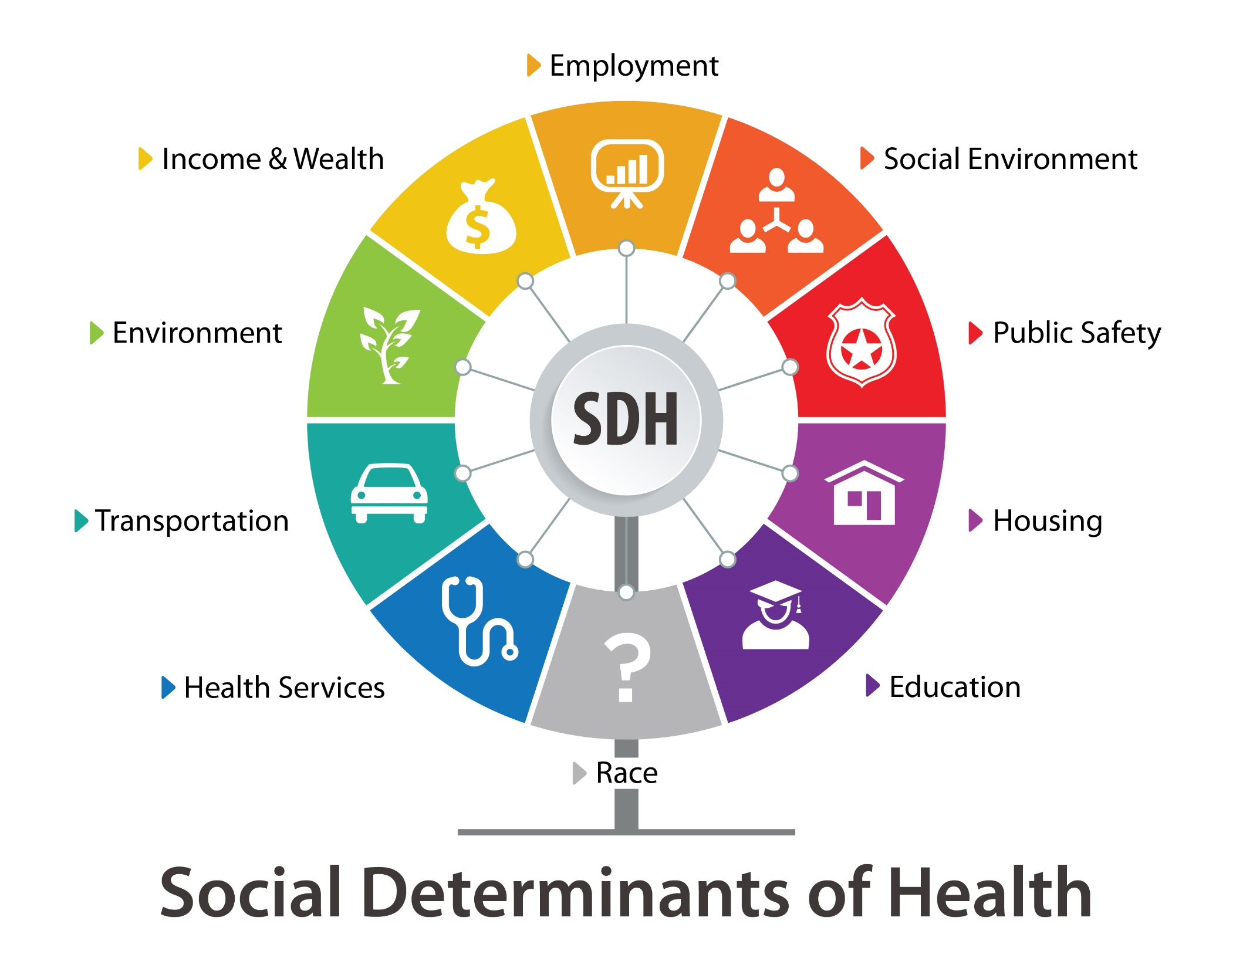
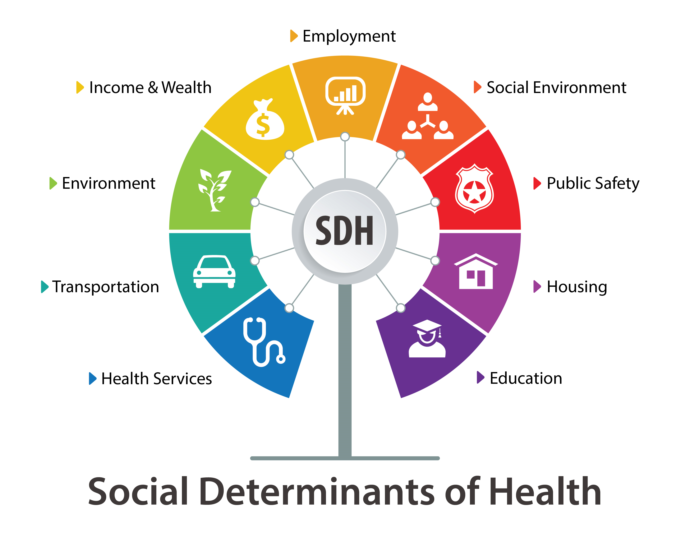
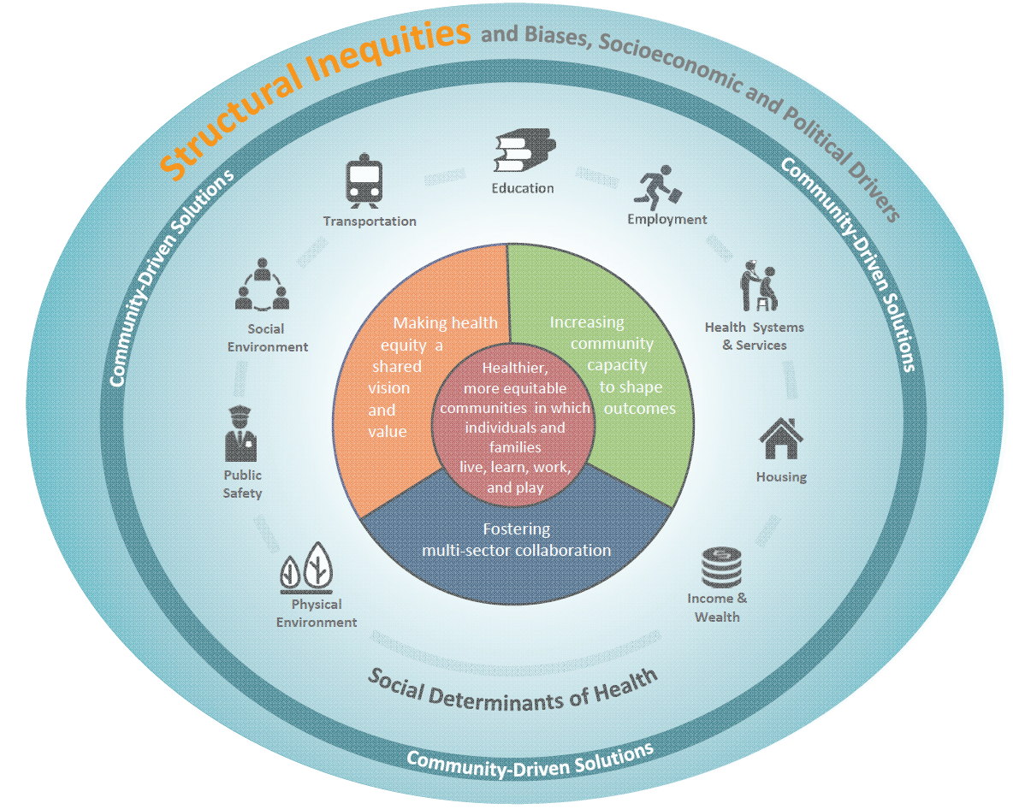
(Communities in Action: Pathways to Health Equity, 2017)
(WHO, 2016; NASEM, 2017; Picha, 2021)

Slide 6

Core Competencies
Patient-Centered Care
  Curricular Content Standard 57
    Identify health care delivery strategies that account for health literacy and a variety of social determinants of health

Slide 7


Slide 8
Teaching Social Determinants of Health
Video-based curriculum for postgraduate pediatric trainees
  Increased screenings by trainees
Service-learning/ community-based learning
Informational videos & simulated patient experiences
  Student attitudes towards those in poverty improved
  Students’ reported feeling empowered to make change
(Decker, 2017; Sabato, 2018; Sharma, 2018)

Slide 9
Goals of Educational Technique
Introduce the concept of SDH
Discuss and explore examples of SDH in general and athletic health care
Use an educational activity designed to promote observation, consideration, and reflection of SDH in clinical practice

Slide 10
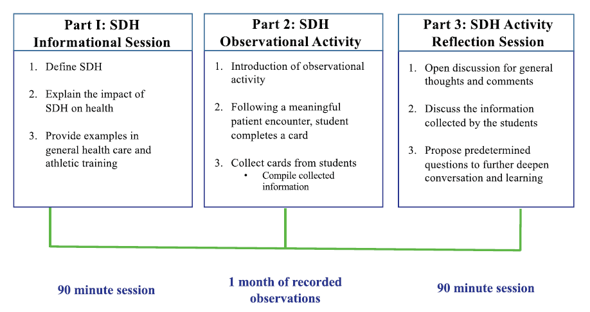
3-Part Educational Technique
(Freiburger, 2021)

Slide 11


Slide 12
Card Studies
Field-tested method for gathering data in the location where patients receive care by those who provide care
  Disease incidence/prevalence
  Practice patterns
  Clinical behaviors
Use short questionnaires clinicians complete on patients with specific conditions
(Green, 1988; Westfall et al., 2011)

Slide 13
Who Completes the Card?
Clinicians
  At time of visit/immediately following patient encounter
Patients
  Immediately or return it later/by mail
(Westfall et al., 2011)

Slide 14

Why Observe?

Slide 15
3-Part Educational Technique
(Freiburger, 2021)

Slide 16
Part 1: Informational Session
Pre-activity survey
  How familiar are you with the concept of SDH?
  How comfortable are you with identifying SDH at the point of care?
  To what extent do you feel SDH contribute to patients health?
  How often do you refer patients to other resources to address SDH?
  My setting has adequate resources available to address SDH.

Slide 17
Part 1: Informational Session
1-hour presentation on SDH
  Concept, impact, examples
30 minutes
  Q & A
  Pair and share
  Instructions on card activity

Slide 18
3-Part Educational Technique
(Freiburger, 2021)

Slide 19
Part 2: Observational Activity
Card study framework
1 month long collection
No patient demographics collected
Designed to take 30 seconds or less to complete card
  Only after meaningful patient encounters

Slide 20


Meaningful Patient Encounters
Prevention, evaluation, treatment, rehabilitation
  Yes After interacting in an evaluation or rehabilitation
  No - After interacting to give a bag of ice
(Van Lunen et al.)

Slide 21
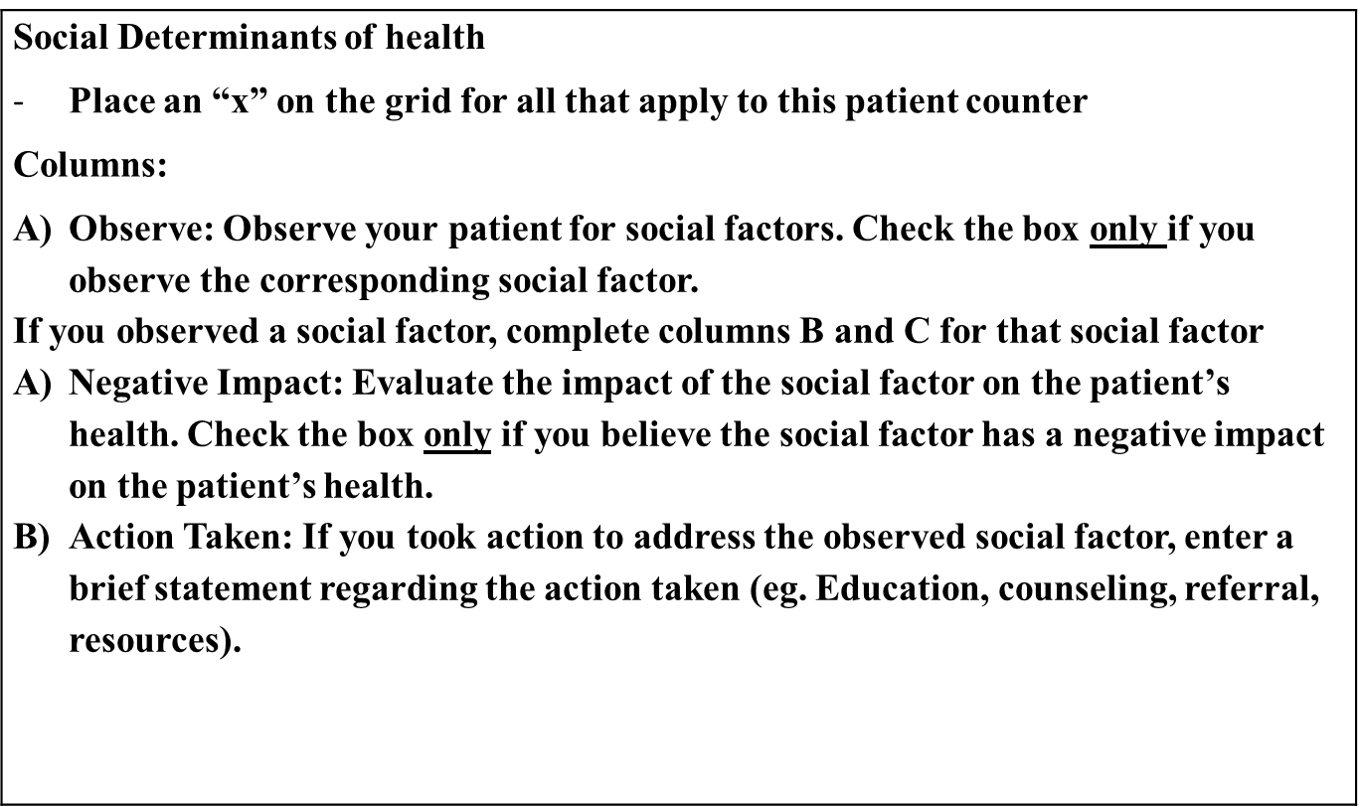

Slide 22
Social Factors | Observed Social Factors | Negative impact on the patient’s health? | Action Taken
Access to social media/emerging technologies
Behavioral health issues
Cultural beliefs/values
Educational limitations
Family care demands
Individual/family life circumstances
Poor social support
Language barrier
Lack of health literacy
Poverty/near poverty
Insufficient/lack of health insurance
Food insecurity
Homeless/poor or unstable living conditions
Transportation issues
Migrant/immigration status
Neighborhood safety
Substance use/abuse
Job/academic stressors
Other: ___________________________________
I am unsure if this patient is affected by any of the listed social factors
I did not observe any of the listed social factors

Slide 23
3-Part Educational Technique
(Freiburger, 2021)

Slide 24
Part 3: Reflection Session
One 90-minute session
Discussed results of collected cards
Used guiding questions to facilitate discussion
Post-activity survey
  Student familiarity and comfort with SDH improved!

Slide 25
Card Activity Results
Social Factors | Observed Social Factors (n) | Negative impact on the patient’s health? (n)
Access to social media/emerging technologies | 104 | 12
Behavioral health issues | 25 | 12
Cultural beliefs/values | 33 | 11
Educational limitations | 14 | 7
Family care demands | 19 | 2
Individual/family life circumstances | 32 | 13
Poor social support | 17 | 9
Language barrier | 13 | 5
Lack of health literacy | 33 | 15
Poverty/near poverty | 11 | 7
Insufficient/lack of health insurance | 11 | 6
Food insecurity | 6 | 3
Homeless/poor or unstable living conditions | 4 | 0
Transportation issues | 33 | 4
Migrant/immigration status | 3 | 2
Neighborhood safety | 6 | 0
Substance use/abuse | 7 | 3
Job/academic stressors | 30 | 13
Other | 3 | 2
Total | 401 | 126

Slide 26
Guiding Questions
What are your general thoughts and feelings about the social factors you observed?
Describe your experiences (eg, successes and challenges) you had observing and identifying potential social factors.
How did you perceive a social factor was having a negative impact on a patient’s health?
  Was determining if a social factor had a negative impact on a patient’s health difficult? Why or why not?
Did you take any action once you identified a negative social factor?
  If so, what did you do? If not, why not?
What resources do you have access to in your clinical setting that could be used to reduce patient’s negative social factors?
  What resources can you think of that would help you improve care when you observe a patient experiencing the negative impact of a social factor?
Were there things that surprised you about your observations?
Have your perceptions about the social determinants of health changed with completion of this activity?
  If so, how? If not, why not?

Slide 27
Post-Activity Survey

Slide 28
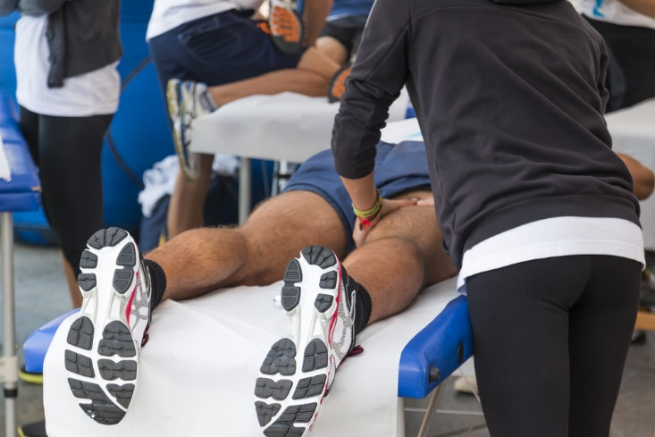

Slide 29
Considerations for Implementation
Post-professional
22 students total
  1st and 2nd year
  Settings: secondary and collegiate
Incorporated into grand rounds programing

Slide 30
Considerations for Preceptors
Are they able to aide in student learning and observations of SDH?
Do they need additional education on SDH?
Can they actively engage in an observation activity with students to further promote conversation and learning?

Slide 31
Athletic Trainers Perceptions
1694 ATs surveyed to determine their perceptions of SDH
Perceptions of…
  Familiarity
  Comfort
  Knowledge (perceived & actual)
(Picha et al. in preparation)

Slide 32
(Picha et al. in preparation)

Slide 33


Slide 34
Clinical Advantages
Active
Reflection
Improved observations
Improved comfort
Improved familiarity

Slide 36
Take Home Messages
There is a need for inclusion of SDH in didactic and clinical education
A card study activity is a viable option for athletic training educators
Student perceptions of their familiarity and comfort in identifying SDH increased

Slide 37

Thank you!
Kelsey Picha- kpicha@atsu.edu

Slide 38
References
Andermann A, Collaboration C. Taking action on the social determinants of health in clinical practice: a framework for health professionals. Can Med Assoc J. 2016; 188(17-18):E474-E483.
Bostic, R. W., et al. (2012). "Health in all policies: the role of the US Department of Housing and Urban Development and present and future challenges." Health Aff (Millwood) 31(9): 2130-2137.
Braveman P. Health disparities and health equity: concepts and measurement. Annu Rev Public Health. 2006;27:167-194.
Braveman P, Gottlieb L. The social determinants of health: it's time to consider the causes of the causes. Public Health Rep. 2014;129 Suppl 2:19-31.
Braveman P, Egerter S, Williams DR. The social determinants of health: coming of age. Annu Rev Public Health. 2011;32:381-398.
Garg, A., et al. (2015). "Addressing social determinants of health at well child care visits: a cluster RCT." Pediatrics 135(2): e296-304.
Hassan, A., et al. (2015). "Improving Social Determinants of Health: Effectiveness of a Web-Based Intervention." Am J Prev Med 49(6): 822-831.
Matthews KA, Gallo LC, Taylor SE. Are psychosocial factors mediators of socioeconomic status and health connections? A progress report and blueprint for the future. Ann N Y Acad Sci 2010;1186:146-73.
Marmot M, Friel S. Global health equity: evidence for action on the social determinants of health. J Epidemiol Commun H. 2008;62(12):1095-1097.
NEJM Catalyst Group. Social determinants of health (SDOH). Patient engagement. 2017. https://catalyst.nejm.org/social-determinants-of-health/.
Noel-London K, Breitbach A, Belue R. Filling the Gaps in Adolescent Care and School Health Policy-Tackling Health Disparities through Sports Medicine Integration. Healthcare (Basel). 2018;6(4).
Pryor, R. R., et al. (2015). "Athletic training services in public secondary schools: a benchmark study." J Athl Train 50(2): 156-162.
Rose, M. S., et al. (2008). "Sociodemographic predictors of sport injury in adolescents." Med Sci Sports Exerc 40(3): 444-450.
World Health Organization. A conceptual framework for action on the social determinants of health. Geneva, Switzerland: WHO;2010.

